Slide 1
Therm = heat
The root therm
thermal
thermostat
thermos
thermometer

Slide 2
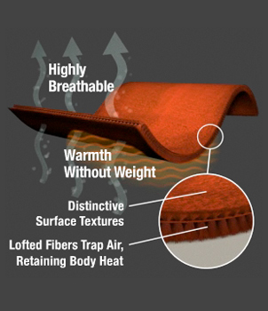
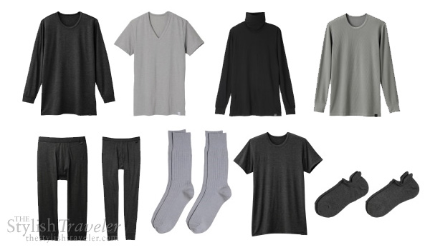
Thermal
heat energy
Thermal Clothing
Designed to promote the retention of body heat

Slide 3
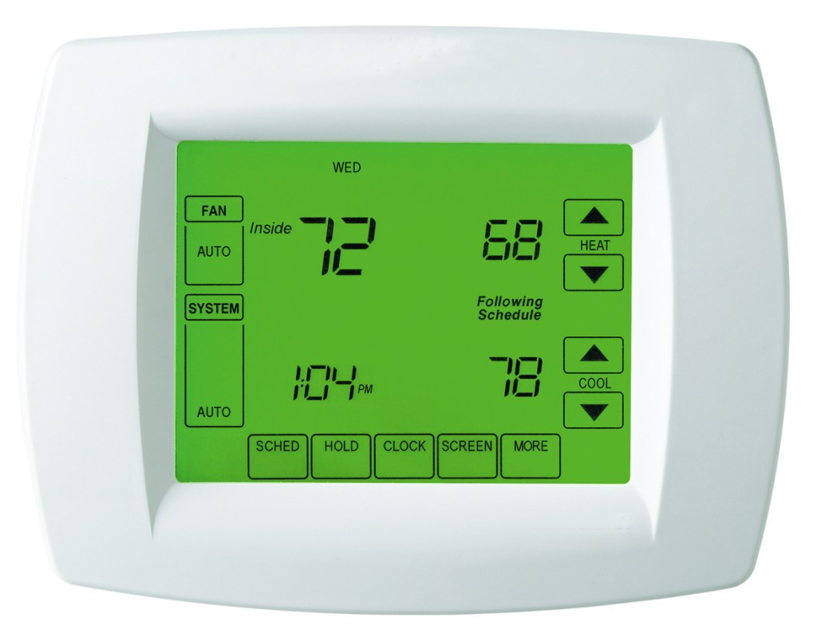
Thermostat
A device that regulates temperature

Slide 4
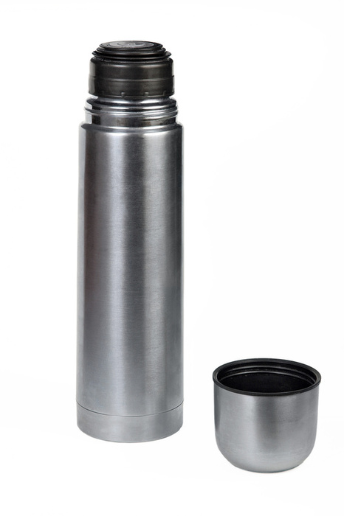
Thermos
a container that keeps a drink hot

Slide 5
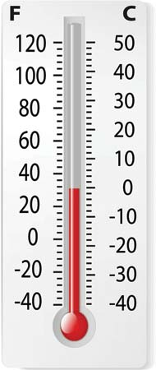
Thermometer
an instrument used to measure temperature

Slide 6
PREFIX POLY MEANS MANY
Polygon
Polysyllabic
Polymer
polytechnic

Slide 7
Polygon
A flat shape with many straight sides

Slide 8
Polysyllabic
Having many syllables
Polygon
Polysyllabic
Polymer
polytechnic
thermal
thermostat
thermos
thermometer

Slide 9
Polymer
A chemical compound made up of small molecules

Slide 10
Polytechnic
Dealing with many technical arts or sciences

